Slide 1
DEPi
Real estate
.NET Developent project

Slide 2
01
02
Table of contents
03
04
Introduction
Overview
Key Informations about the Application
An overview over the program
Training Focus Areas
Final Project
Topics and focus areas
discussed in the training

Slide 3
01
Introduction

Slide 4

pahses
Phase 1
Phase 2
Setup and Property Management
Tenant Management and Lease Agreements

Slide 5
Phase 3
phase 4
Rent Payments and Reporting
Final Testing, UI Enhancements, and Deployment

Slide 6
02 Overview
Property & Tenant Management
Allows property managers to easily add, update, and manage property details, tenant information, and lease agreements, simplifying day-to-day administrative tasks.
Rent Payments & Financial
Tenants can make online rent payments, while property managers can track payment history, generate financial reports, and gain insights into outstanding payments.
User Authentication & Role-Based Access
Secure login system with role-based access control, ensuring that property managers and tenants have different permissions based on their roles, enhancing security and operational clarity.

Slide 7
Problem statement
Inefficient Property & Tenant Management
Difficulty in keeping track of multiple properties, tenant details, lease terms, and occupancy statuses, often resulting in missed deadlines or incomplete records.
Manual Rent Payment Processing
Collecting rent manually can lead to delayed payments, difficulty in tracking payment history, and issues with accountability for both tenants and property managers.
Key challenges faced by property managers and tenants include:
Property and Project Development
difficulty in accurately tracking property maintenance and compliance with regulations throughout the project lifecycle. Without a centralized system, developers may struggle to manage inspections

Slide 8
Objectives and Goals of
the Real Estate Property Management

Slide 9
Objectives and Goals
Streamlined Property Management
Implement a user-friendly interface for property managers to efficiently manage property listings, tenant information, and lease agreements. This aims to reduce administrative overhead and enhance operational efficiency.
Tenant Empowerment
Provide tenants with self-service capabilities to view lease details, submit maintenance requests, and make online rent payments. This objective focuses on improving tenant satisfaction and engagement through better accessibility

Slide 10
Goals
Role-Based Access Control
Establish a secure user authentication system that differentiates access levels between property managers and tenants. This objective ensures data integrity and protects sensitive information while allowing users to access relevant functionalities
DAY Efficient Lease Management
Implement features for creating, editing, and terminating lease agreements with ease. This goal aims to streamline lease management processes, ensuring timely renewals and reducing administrative burdens.

Slide 11

Project Scope and Requirements

Slide 12
Functional Requirements:
User Management
Admins manage properties, property managers handle assigned properties, and users access listing
Property Management Module
allow property managers to add, update, and delete property listings, including details such as location, size, amenities, and pricing. Users should be able to view property details and search/filter listings based on specific criteria
Lease Agreement Management
should track key lease details such as start and end dates, payment terms, and any special conditions.

Slide 13
Functional Requirements:
Document Management
support uploading and managing important documents related to properties and leases, such as contracts, inspection reports, and correspondence. Users should be able to easily access, download these documents.
Automated Payment Generation:
generate upcoming payment records based on established lease agreements.
scheduled payments are created without manual intervention, reducing errors and ensuring that both tenants and property managers are consistently informed

Slide 14
Target users or beneficiaries
Property Managers:
benefit from streamlined
management of listings, tenants, lease agreements.
Tenants:
They will have easy access to view lease details, make rent payments, and report issues.
Real Estate Agencies:
Agencies will gain improved efficiency in tracking tenant information and payments.

Slide 15
System Architecture/Design

Slide 16
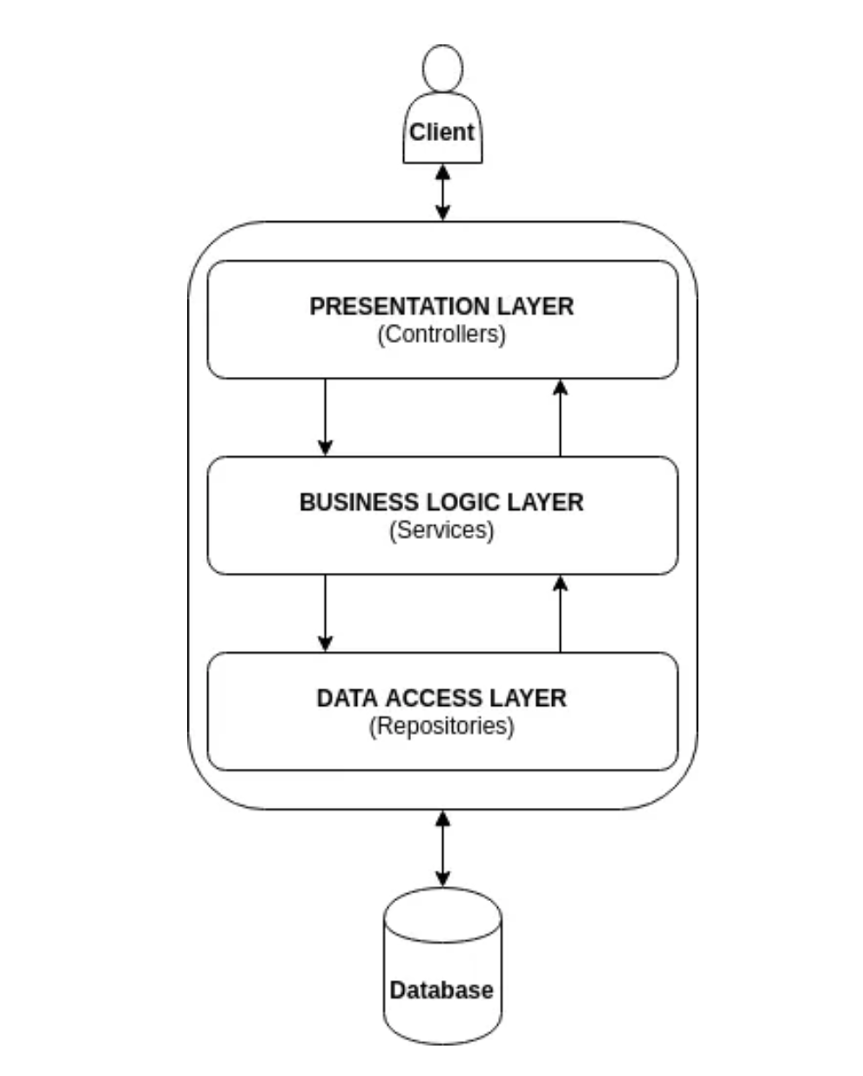
Presentation Layer
Controllers
Data Access Layer (DataAccessLayer project):
Handle user requests and manage the flow of data between the view and the business layer.
Views
Service Layer
Render the user interface using Razor syntax.
Offer a service-based interface for external systems or components
DTOs (Data Transfer Objects): Used for data exchange between layers.
Models: Represent the data structures used in views.

Slide 17

Technology stack
3. SQL Server
relational database for storing and managing property and tenant data.
Short terms
4. HTML/CSS/JavaScrip/ Bootstrap
5. Identity Framework
1. ASP.NET Core
6.RESTful API
Robust framework for building web Apps.
For enabling communication between the front-end and back-end services, allowing for seamless data retrieval and manipulation.
2. Entity Framework
An (ORM) that simplifies database interactions and migrations.

Slide 18
Data Flow
1 User Interaction:
Users interact with the web application through the UI to manage properties, leases, and payments.
2 Request Handling:
User actions trigger HTTP requests, rocessed by the ASP.NET Core controllers, routing them to the appropriate service.
3 Database Operations
Entity Framework interacts with SQL Server, executing CRUD operations .
4 Response and Display
Data is fetched or modified, processed by the application, and sent back to the UI to display the updated information or feedback to the user.

Slide 19
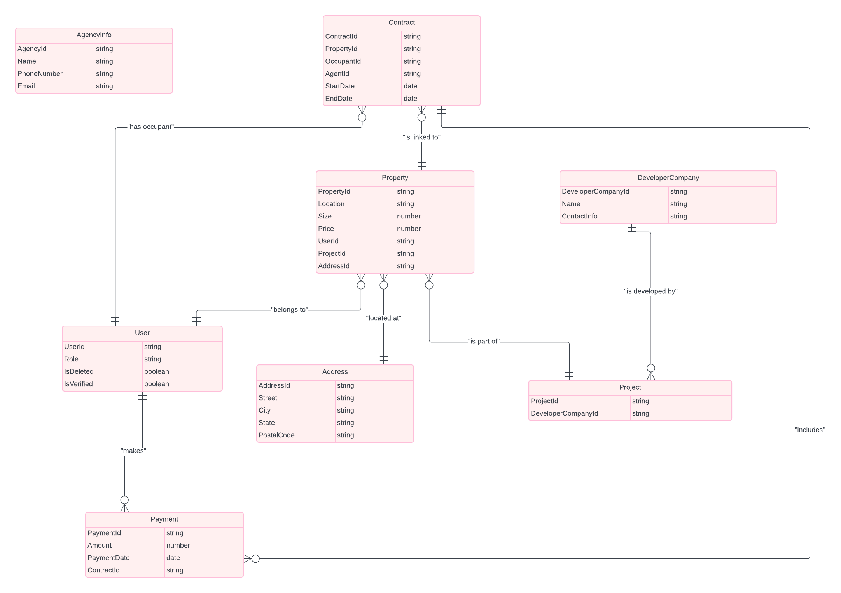
entity relationships

Slide 20
user interface

Slide 21
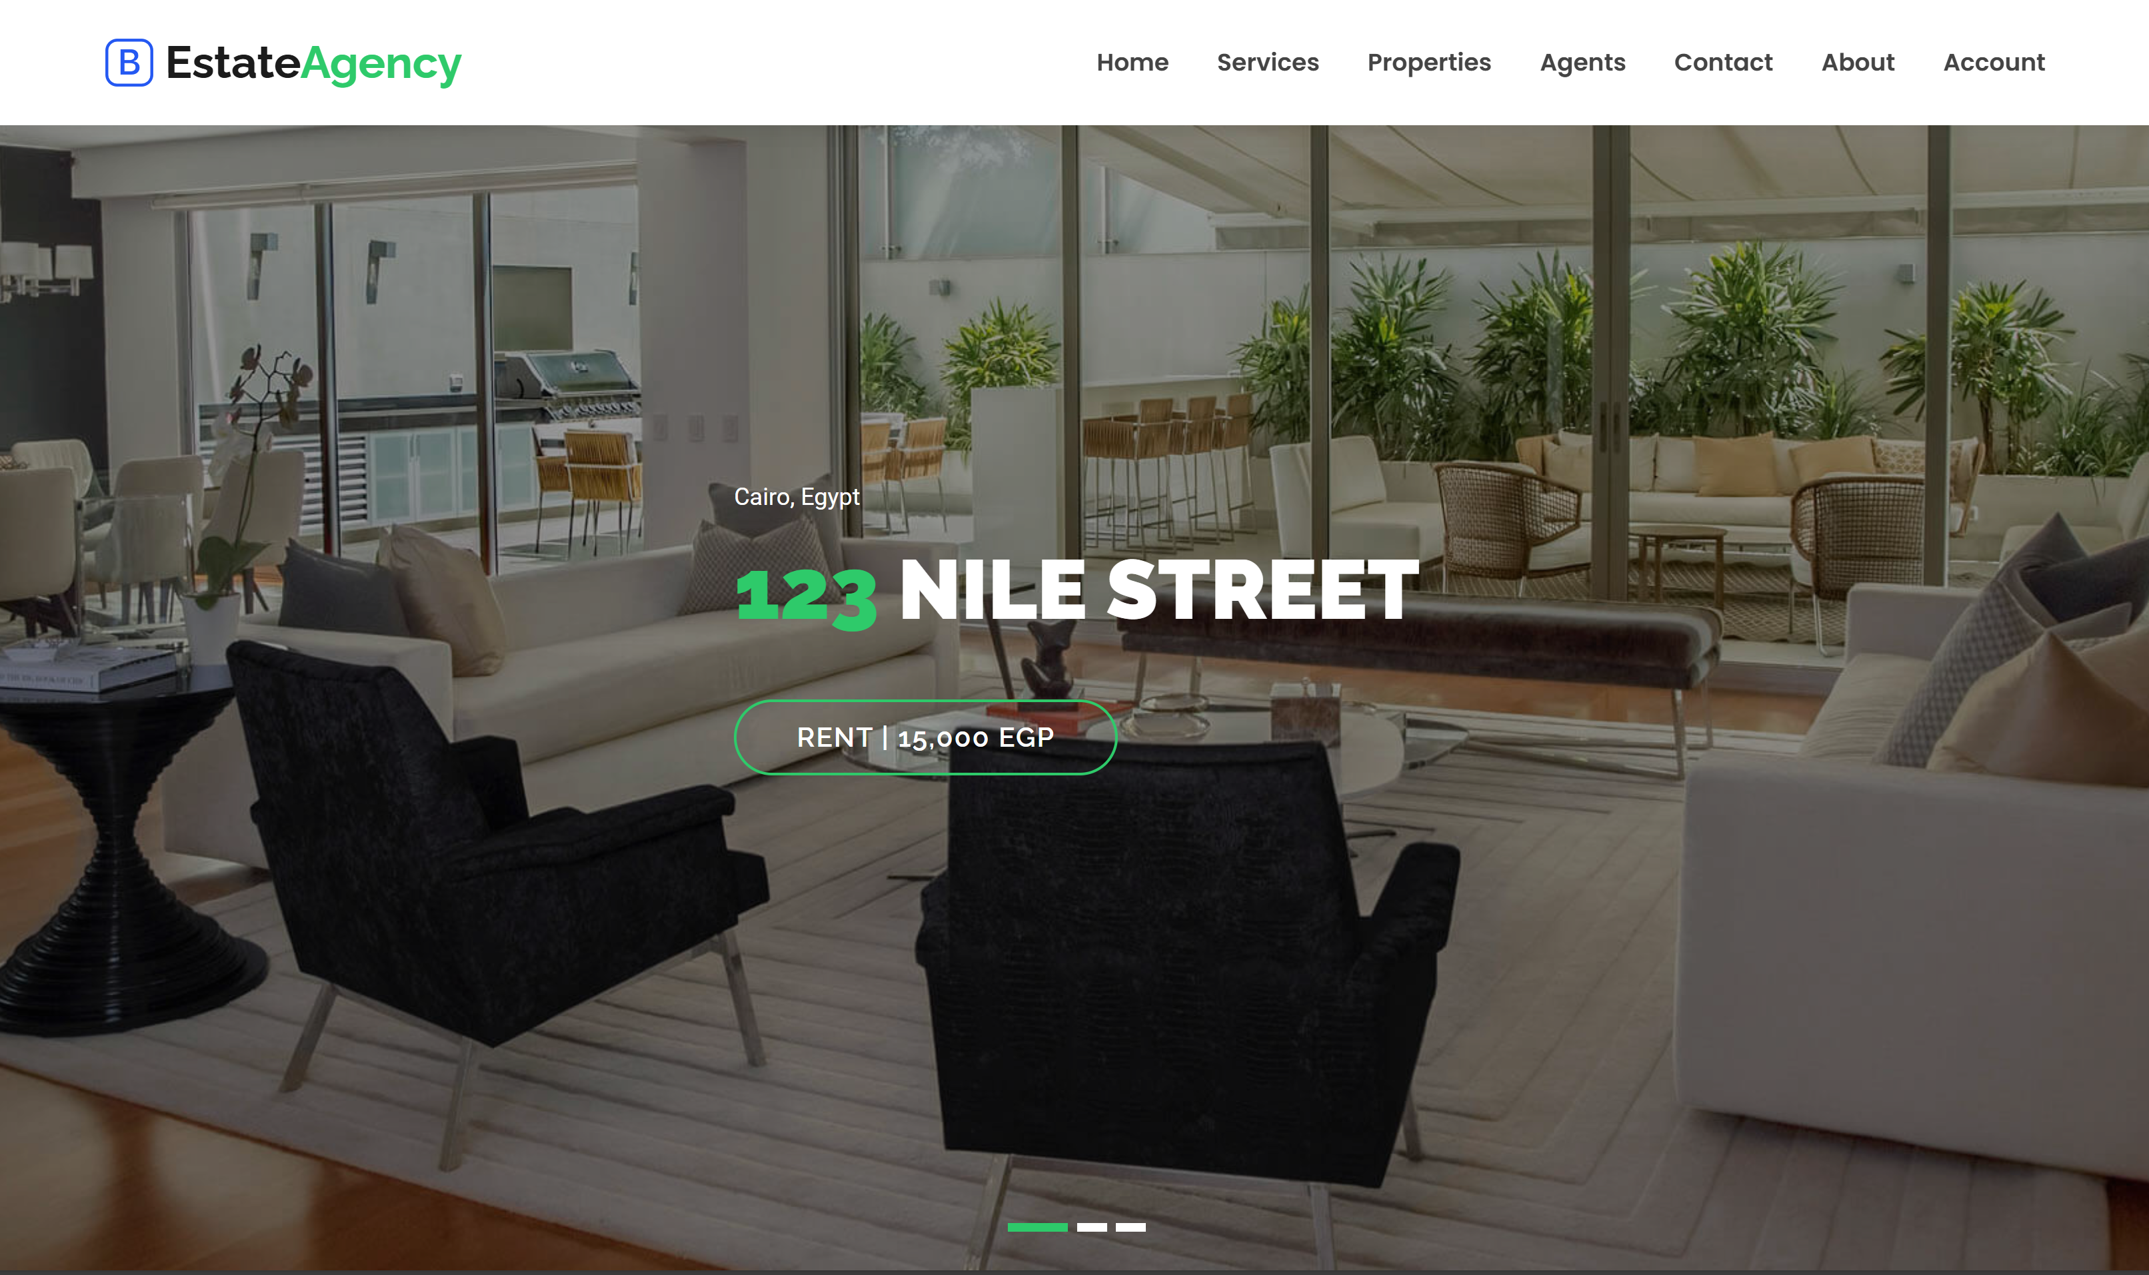
Home

Slide 22
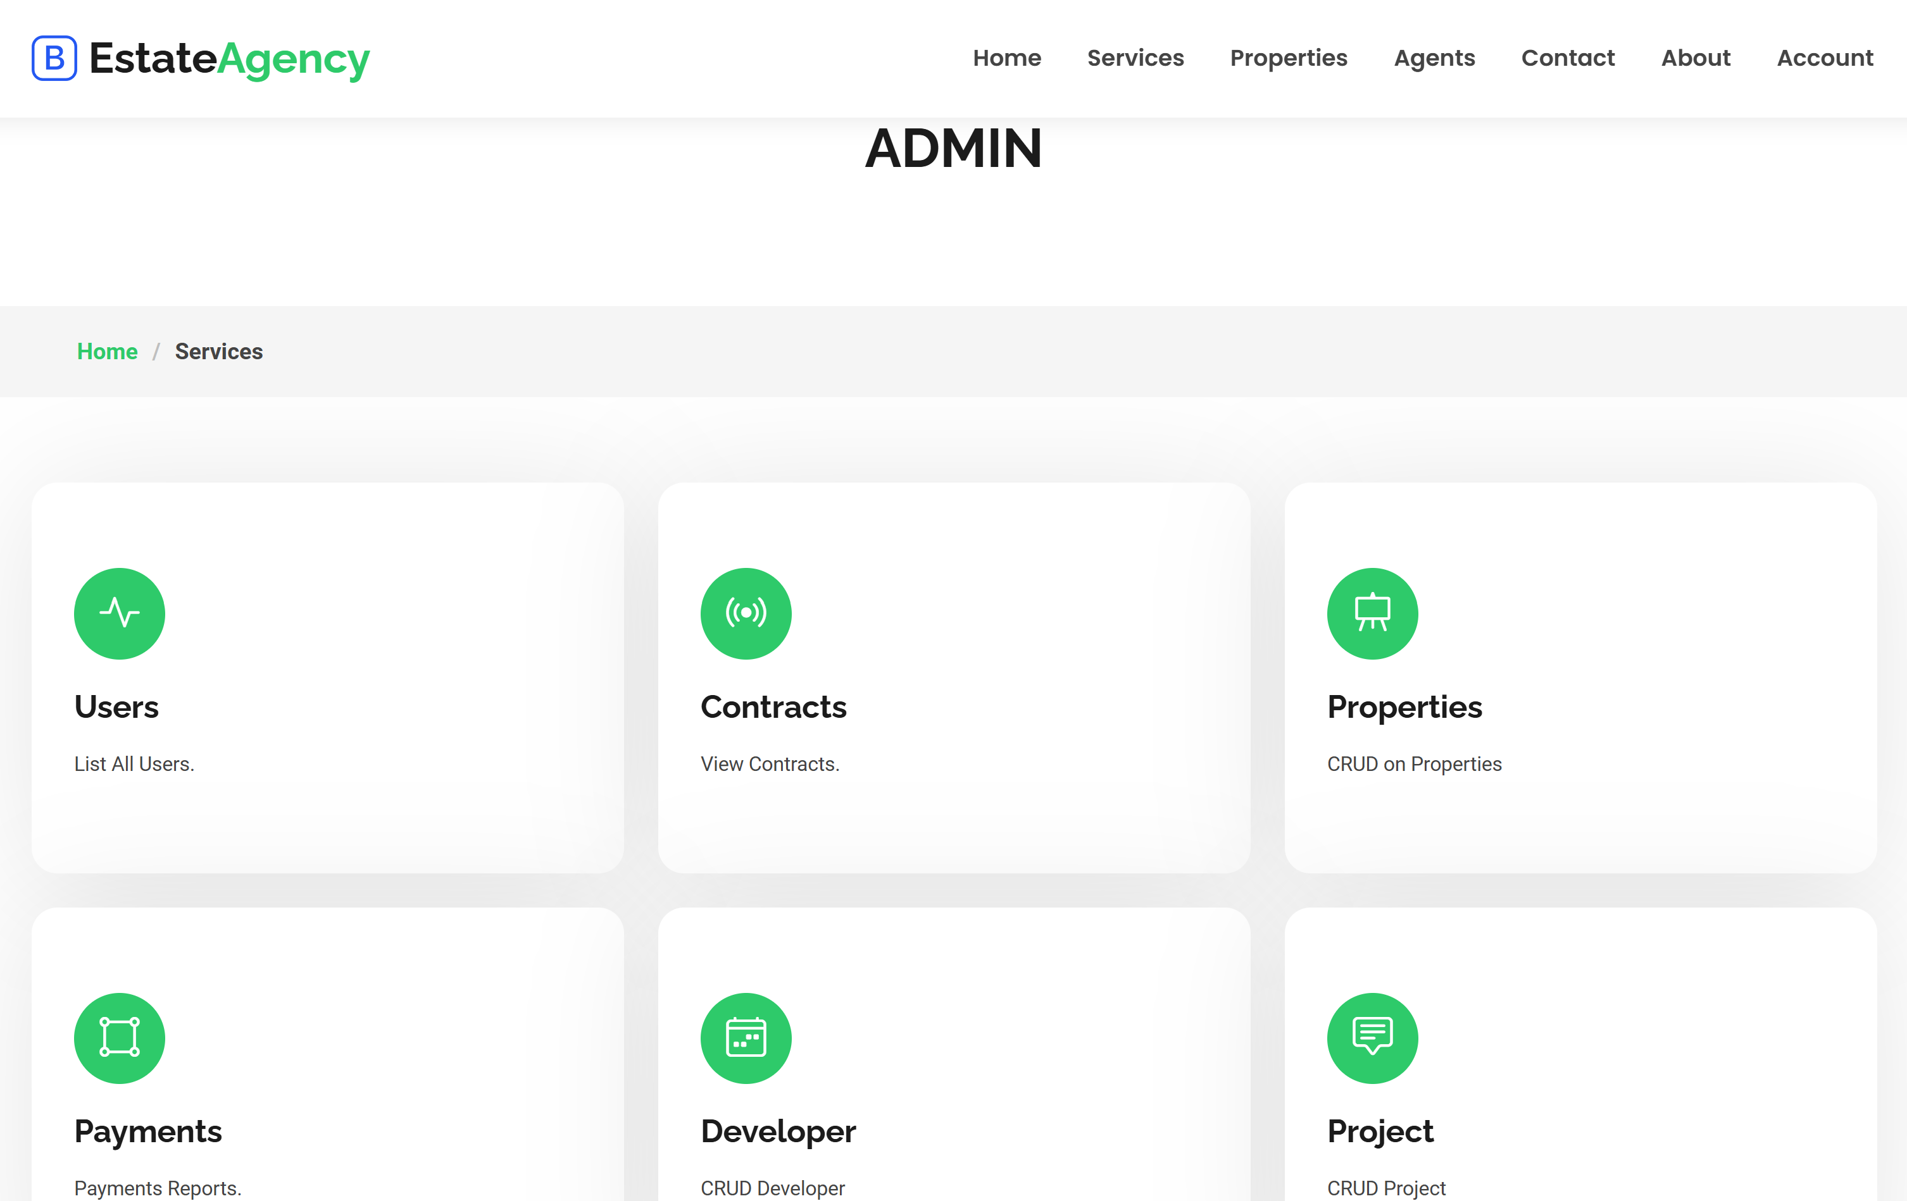
Admin interface

Slide 23
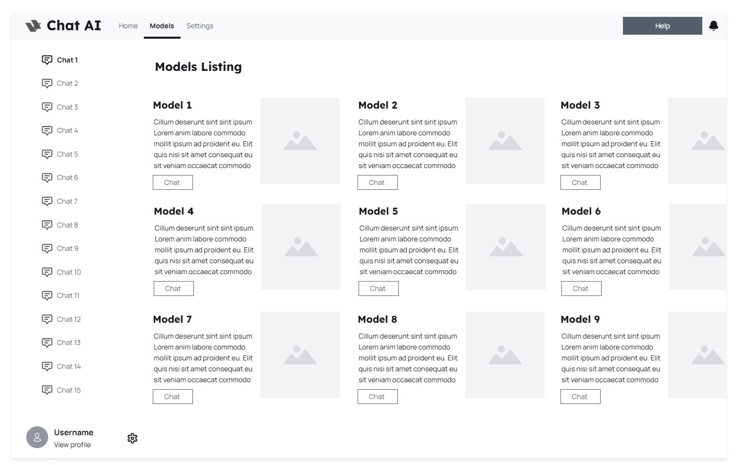
MODEL SELECTION

Slide 24
INTEGRATION

Slide 25

INtegration APIs
ONNX
OLLAMASHARP
web api
OLLAMACLIENT

Slide 26
AI Model Capabilities
Deep
High
Deep Contextual Understanding
High-Quality Text Generation
Complex
Enhanced
Complex Query Handling
Enhanced Language Comprehension

Slide 27

objectives
Manage Data Effectively
Chat Service
Integrate AI Models
a scalable service for handling user messages and AI interactions, with efficient data management.
Connect with OllamaSharp API for AI responses, including model selection and management
CRUD operations for chat sessions and messages using an in-memory database for testing
Error Handling
User-Friendly Interface
Testing Procedures
robust error handling and logging to track and manage issues.
intuitive UI for users to start sessions, send messages, and view interactions.
comprehensive tests to validate functionality, integration, and performance.

Slide 28
Conclusion
Summary
• Acquired foundational skills in
C#, OOP, Database Design, LINQ, Entity Framework, and
MVC
• Practical experience through
daily tasks and a final project
Reflection
• Gained confidence in building
web applications and
managing databases
• Expanded understanding of
software development in
the .NET ecosystem

Slide 29
Thanks
Do you have any questions?
ibrhmahmd743@gmail.com
+20 0100852094
@ibrhmahmd

